Slide 1
Software Engineering and Architecture
Build Management

Slide 2
Motivation
Oracle provides Java SDK free of charge
provides standard command line tools: javac, java, ...
These are sufficient only for small systems
javac only compile one directory at a time
javac recompiles everything every time
Large systems require many tasks
manage resources (graphics, sound, config files)
deployment (making jars, copying files, upload to repos)
management (javadoc, coverage, version control)
Reliability require reliable processing
Creating the system exactly the same way every time

Slide 3
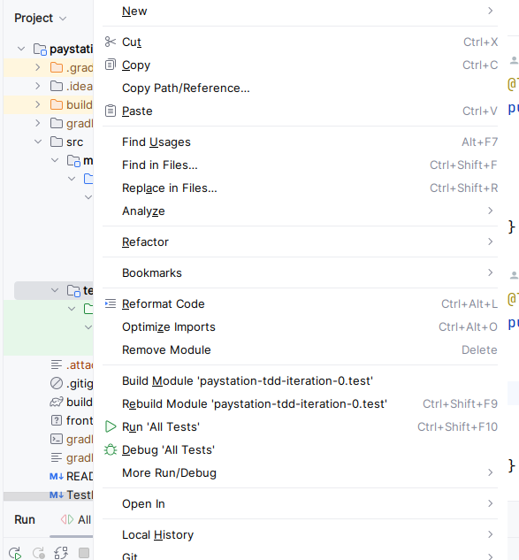
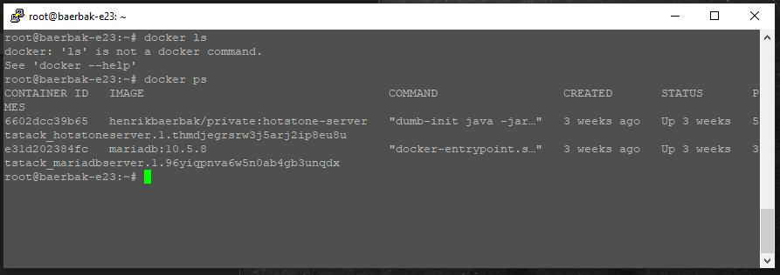

Modern IDEs hide the fact
IntelliJ, Visual Studio, etc. include build management tools
Compile all (touched) files, etc.
But what do you do when your code is on a server in Helsinki?
Only the “shell/commandline” available

Slide 4
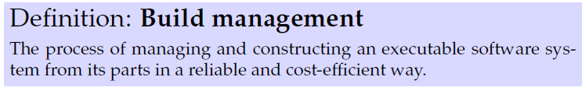
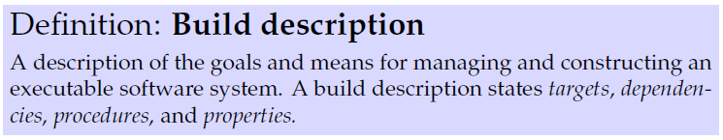
Build-Management
This problem is denoted:
Computer Scientists’ standard solution: a tool...
The tool read a build-description
Example: Make (Feldmann, 1979)

Slide 5
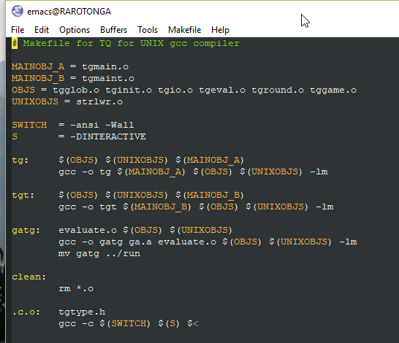
History…
Make

Slide 6
The Two Ways
Programming languages comes in flavors
Procedural languages
‘express how to achieve a goal’
Declarative languages
‘express what goal you want to achieve’
Old time build languages were procedural (ex: make, Ant)
Write code to compile all source files
Modern build languages are declarative (almost)
‘compileJava’ is built into the system

Slide 7
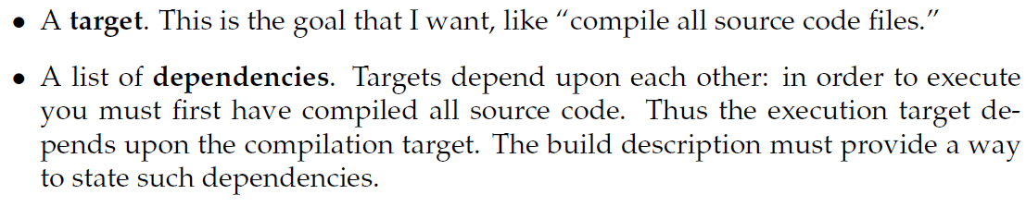
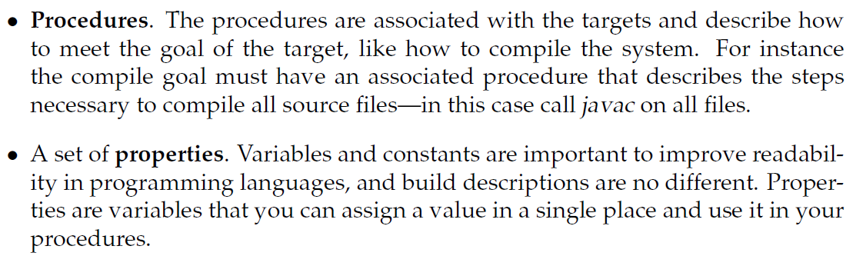
Script Parts

Slide 8
Apache Ant
Ant is a build-management tool geared towards Java
☺ has some strong build-in behavior
javac on source trees and does smart recompile
☺ independent of large IDEs
☹ was created on the XML buzzword wave so it is verbose
☹ is very evolutionary in its design
Do the same thing in a zillion different ways
No ‘conceptual integrity’

Slide 9
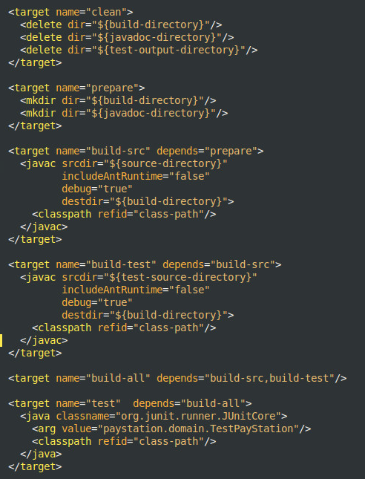
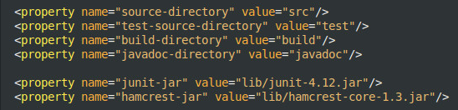
Example
Targets
‘test’ …
Dependencies
‘test’ d.o. ‘build-all’ d.o. …
Procedures
<javac ….>
Properties
{$build-directory}

Slide 10
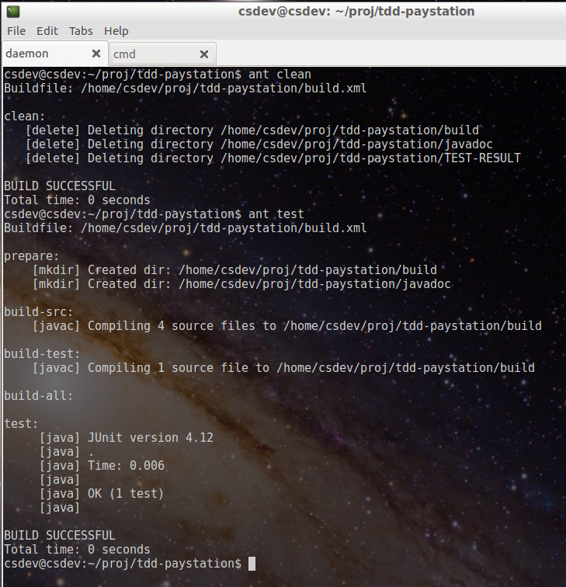
As In

Slide 11
Gradle in SWEA
In 2018 Ant was put to rest…

Slide 12
Gradle
Gradle is a convention-based build-management tool
Convention over configuration is the mantra!
Which means
You cannot see a damn thing about what it does in its build description (build.gradle) !!! ☹ ☹ ☹
You have to know all the conventions or google your butts off ☹
Conventions:
A fixed set of targets are defined (compileJava, test, …)
The source folder hierarchy and naming are hard coded!
The ‘build description’ is in build.gradle in the project root
A bit of help: ‘gradle tasks’ will display all known targets.

Slide 13
And One BIG Nuisance
Gradle developers are not afraid of none-backward-compatible changes ☹ ☹ ☹
Indeed they syntax and semantics have slightly or in code-breaking ways changed 30 times since I started using Gradle 
So many hours wasted on absolutely nothing…
Beware of slides that may contain old-style gradle ☹

Slide 14

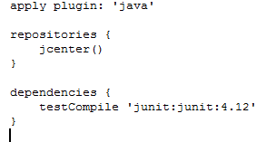
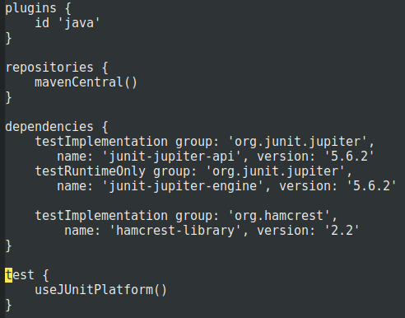
Gradle build.gradle
The simplest build.gradle file for java dev, contains one line
apply plugin: ‘java’
And now you can do all basic BM tasks (except running a program! ☺)
gradle test
Will compile all production code, all test code, and execute all Junit code in the ‘test’ source tree

Slide 15
Gradle
How does it work? Magic???
By convention
You must put your code in the right folders!
src/main/java/HERE
src/test/java/HERE
Predefined targets
Like ‘test’, ‘compileJava’, …
By plugins
Which are procedural groovy code to inject into the gradle framework
(‘framework’ is a central topic of this course)

Slide 16
Gradle
Gradle is also a dependency-management tool
Ex: we need hamcrest
Gradle will download ‘org.hamcrest….:2.2’ from MavenCentral on the internet, and set the classpath correctly
Notes:
To see that, go to ~/.gradle/caches/module-2 and remove everything; will force gradle to download everything again.

Slide 17
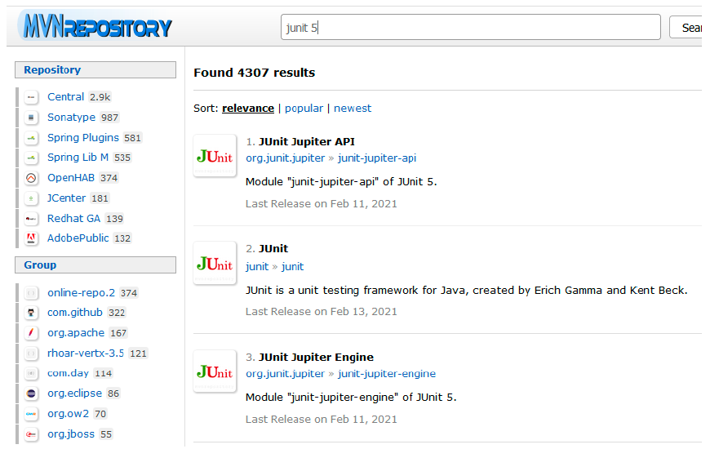
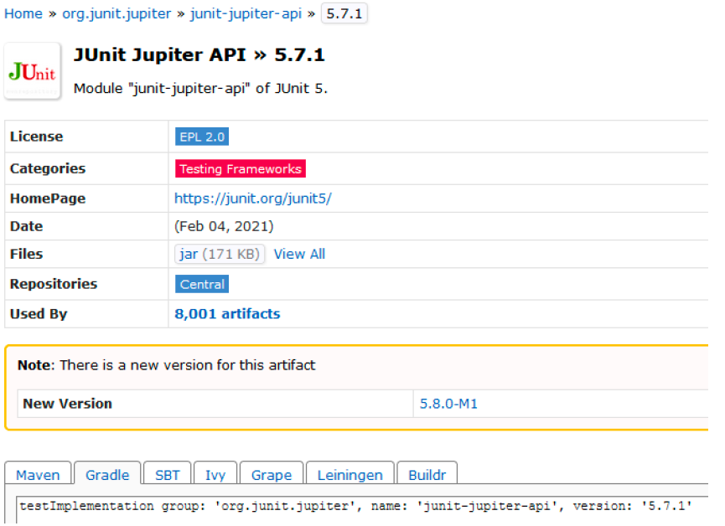
MavenCentral
Find libraries on ‘www.mvnrepository.com’

Slide 18
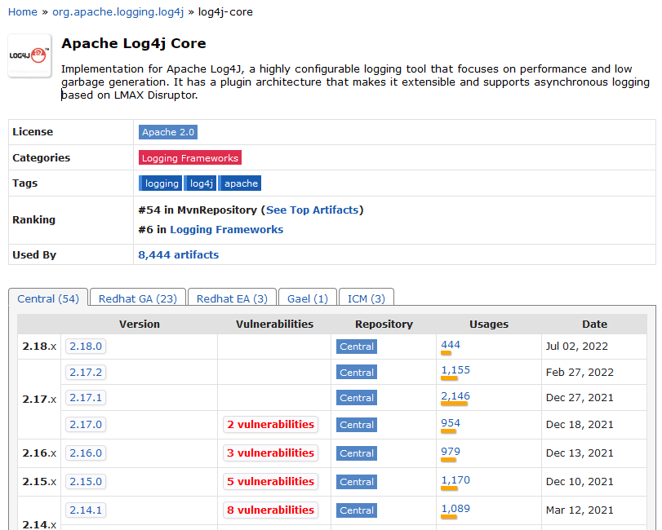
Update from time to time!
Lists security issues

Slide 19
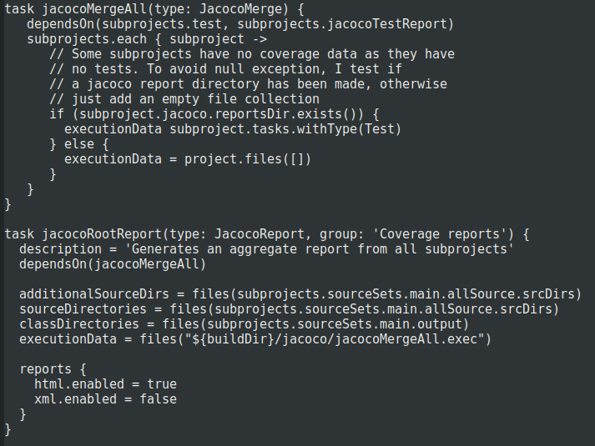

Gradle
Gradle combines both declarative and procedural
If you follow ‘gradle conventions’ it knows what you want to do
gradle test, etc.
And ‘task’ let you write complete groovy code, if you need it
But – normally you don’t!

Slide 20
Analysis
Predefined
Predefined
Predefined

Slide 21
In SWEA…
Build management using Gradle is a postulate and requirement
No exercises in making Gradle targets, groovy code, etc.
Required for easy hand-in and easing the TA work
Hard requirement: ‘gradle test jacocoTestReport’ must always run without errors, and must always execute all your tests!

Slide 22
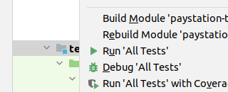
IntelliJ
Why not just use IntelliJ?
It does it all, right?
Answer
True but…
Gradle can do stuff that IntelliJ can not.
Servers do not have a graphical interface!

Slide 23
Other BM tools

Slide 24
Maven
Ant is pretty old…
It is a Domain Specific Language and procedural
Tasks define ‘what to do’
Maven
‘Convention over configuration’
You follow the conventions and then Maven knows all the tasks!
It is a DSL and it is declarative
mvn compile, mvn test, mvn install
Very very good for publishing libraries on Maven repository
Maven directly supports dependency management (POM)
Ant requires help from Ivy to do that
No support for running code ☹

Slide 25
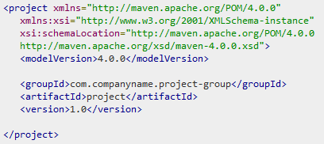
Maven POM
Basic POM just states what the identity of your project is
Note:
This simple POM can handle every classic aspect (except running a program!)
Yeah – we all love XML ☺

